Slide 1
Using Anthropology to study Security Incident Response
Raj Rajagopalan Xinming Ou
Honeywell Kansas State U
FIRST 2014
June 25, 2014

Slide 2
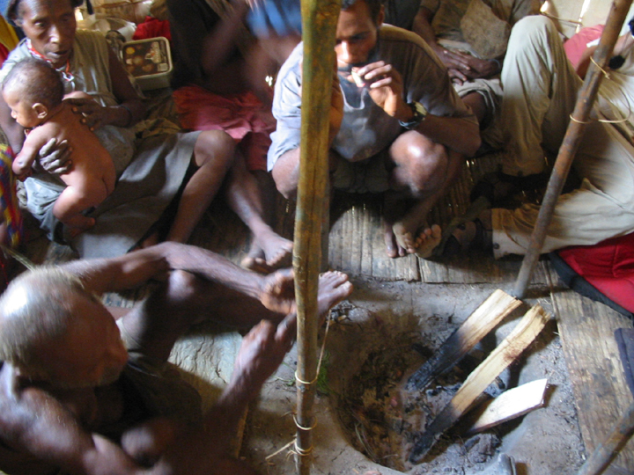
The Team
Sathya Chandran, Mike Wesch, Simon Ou (KSU)
John McHugh (RedJack) Dan Moor (HP)
Raj Rajagopalan (Honeywell)
Partially supported by an NSF grant. Opinions are those of the authors.

Slide 3

SOCs and CSIRTs are the heart of our cyber defense and yet
… we cannot articulate how they thrive

Slide 4
E.g. We don’t know how to make incident handling more automated how to train new analysts quickly how to share knowledge effectively

Slide 5
To do this we have to know what makes a SOC/CSIRT really work
But don’t we know that already?
But first a little story…

Slide 6
Back in 2006 a group of intrepid security researchers were on a mission to find out how to build an effective IDS
So they went to the nearest SOC/CSIRT which happened to be the one on campus
What did they learn?

Slide 7
What we saw
We observed the SOC handle a malware incident affecting campus servers.
What we saw was not what we expected

Slide 8
What we saw
SOC analysts don’t use high tech tools!
Most of the work is grubby manual work
Most of the analysis is based on personal experience

Slide 9
What we learned
Security analysis is a people problem more than a technology problem!
Academic security research is well-separated from the practice of cyber security.
Vendors to the SOC were not doing much better.

Slide 10
What we did
We asked the SOC analysts how they did their jobs
How did that work?
Not well.
What did we miss?

Slide 11
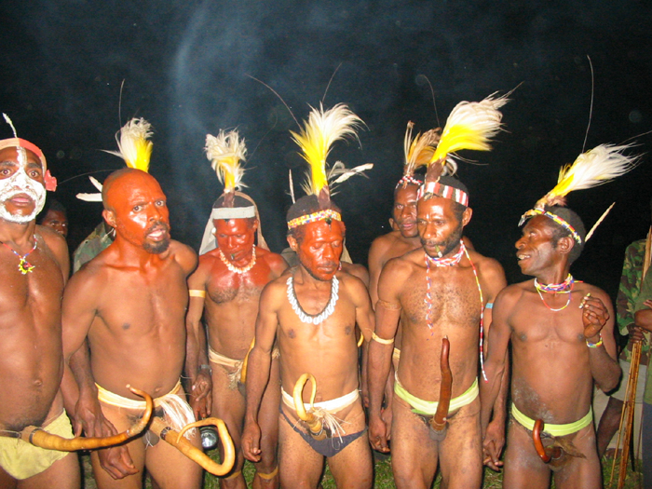
What we set out to observe

Slide 12
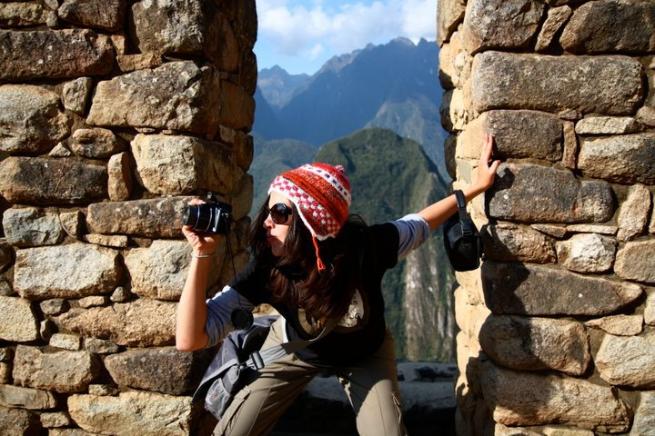
What we became
Notes:
Not just that we did not comprehend what we were observing, we could not – we simply did not have the ability.

Slide 13
Time for Reflection
The researchers could not get time of day from the SOC staff
SOC personnel were too busy and too suspicious
SOC skills are learned primarily via a master-apprentice model
The researchers were on the outside looking in!

Slide 14
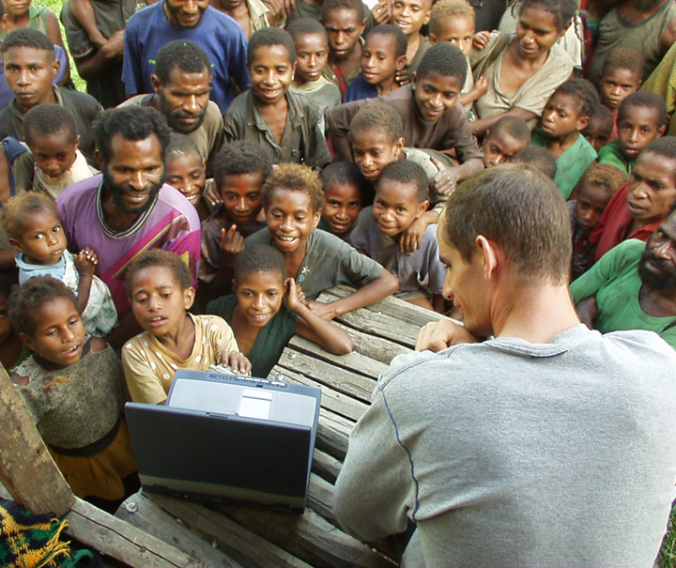
The Professional Observer
Dr. Mike Wesch, Socio-cultural Anthropologist
to the rescue!

Slide 15
Introduction to Anthropology
The study of all people in all times in all places
See the big picture and the small picture at the same time.

Slide 16
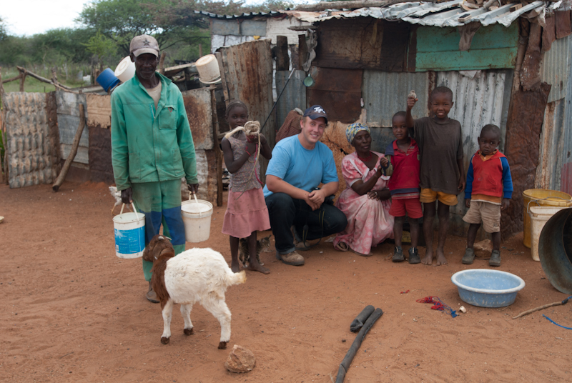
What we think Anthropologists do!

Slide 17
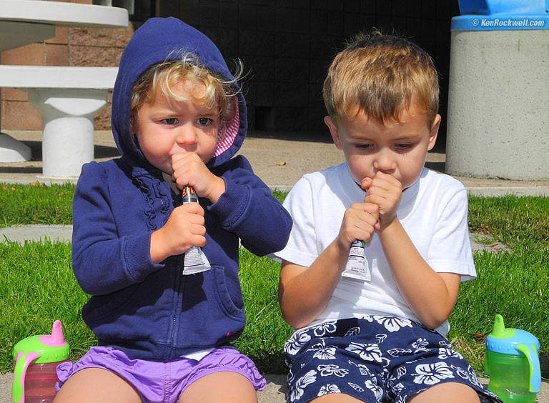
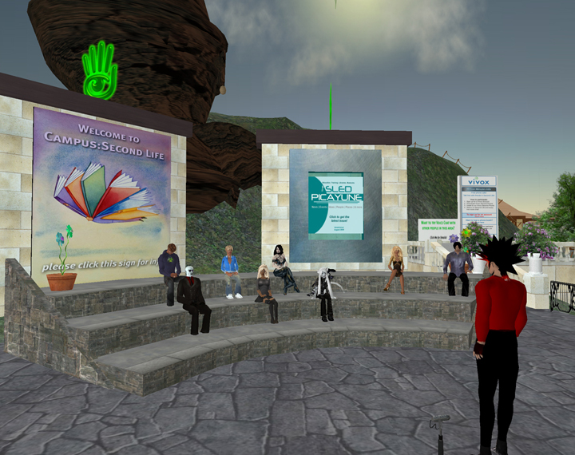

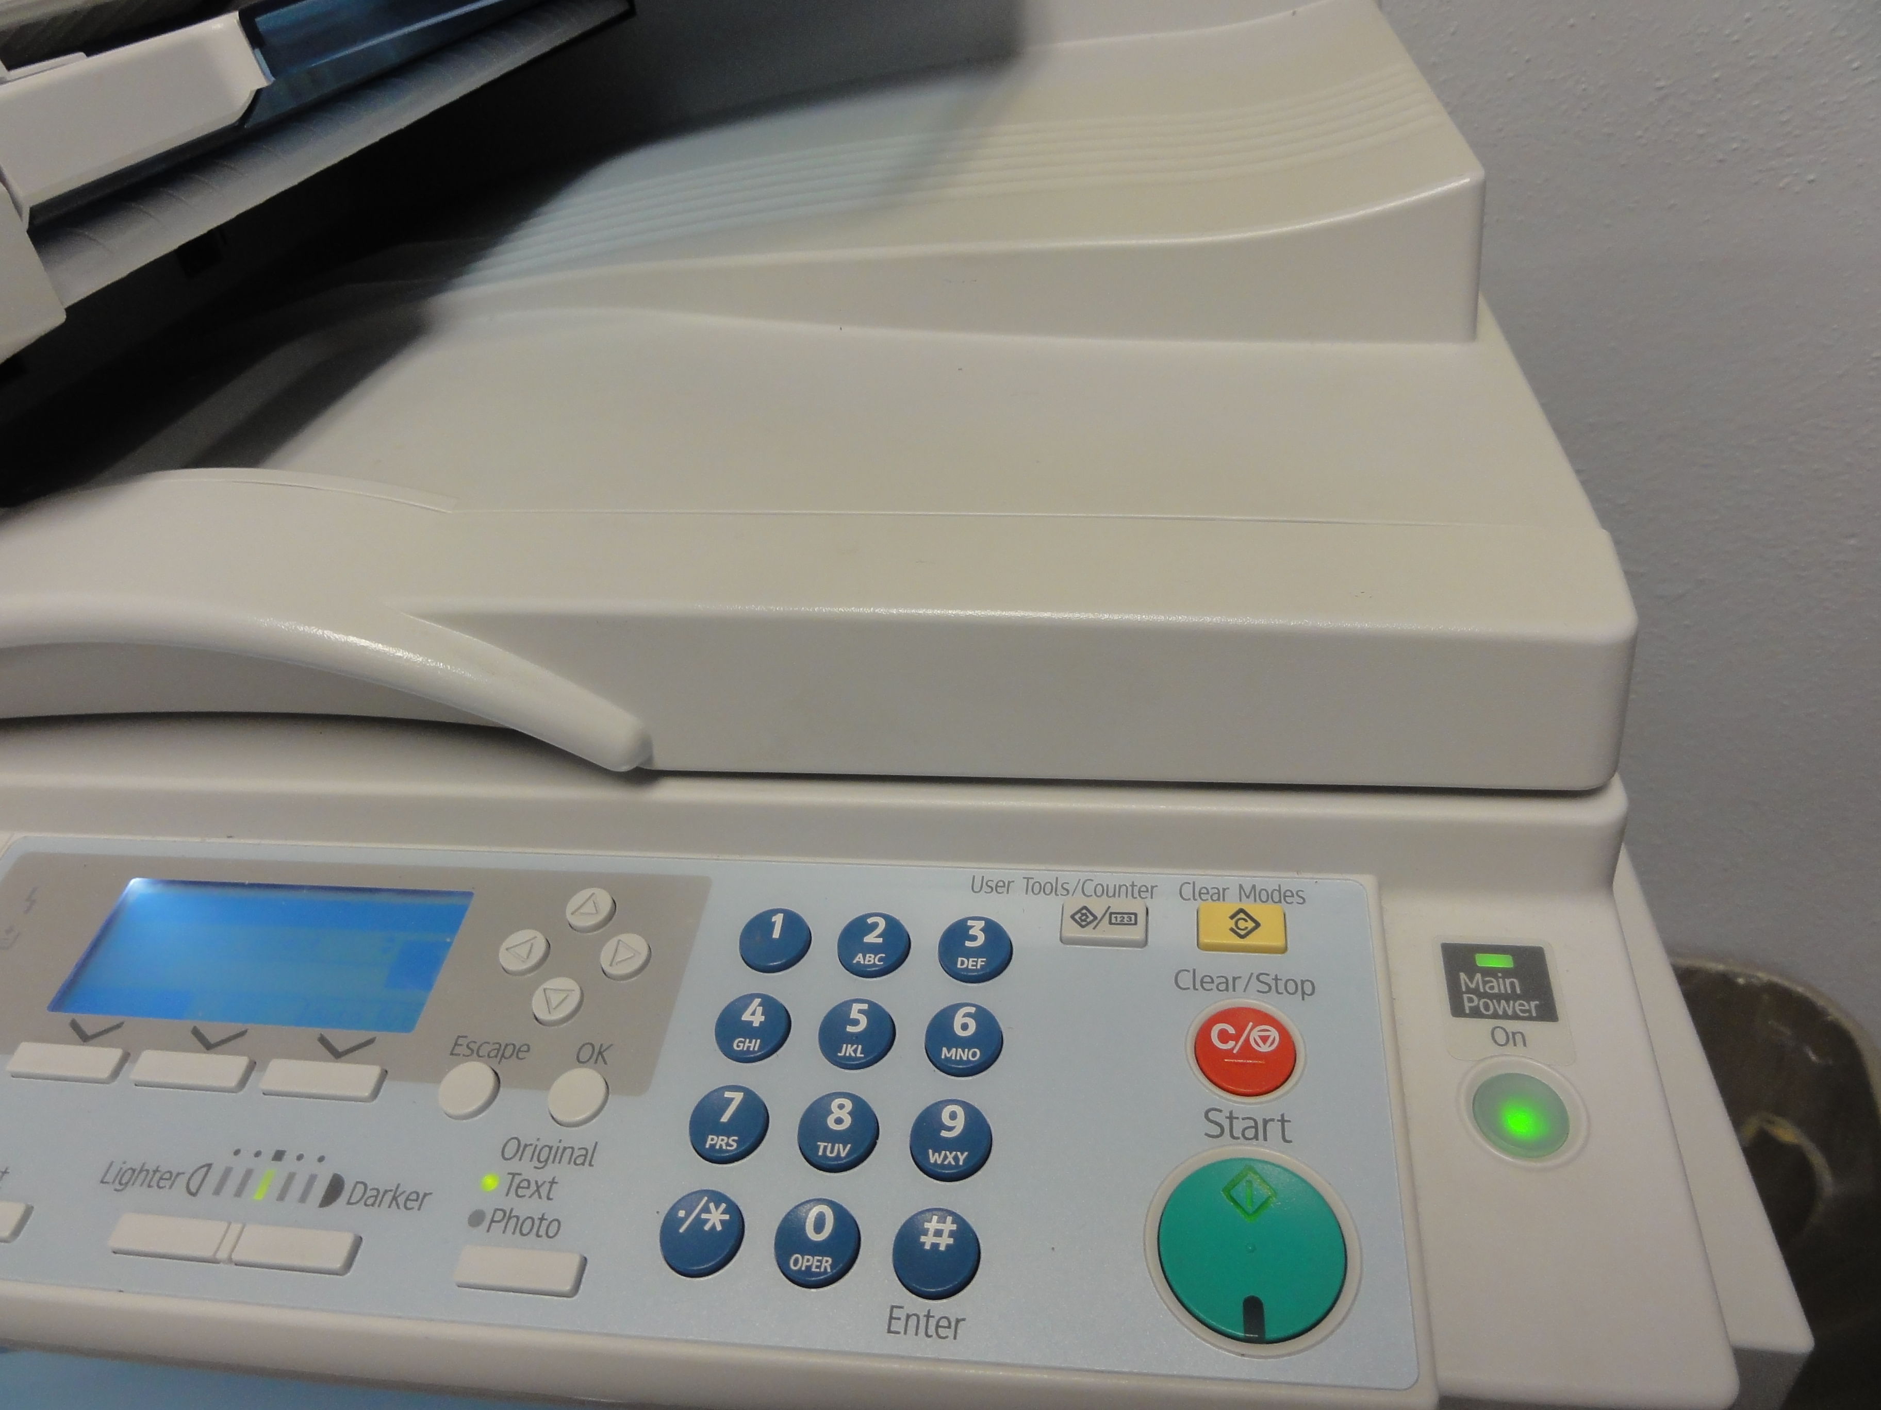
Other things Anthropologists do!

Slide 18
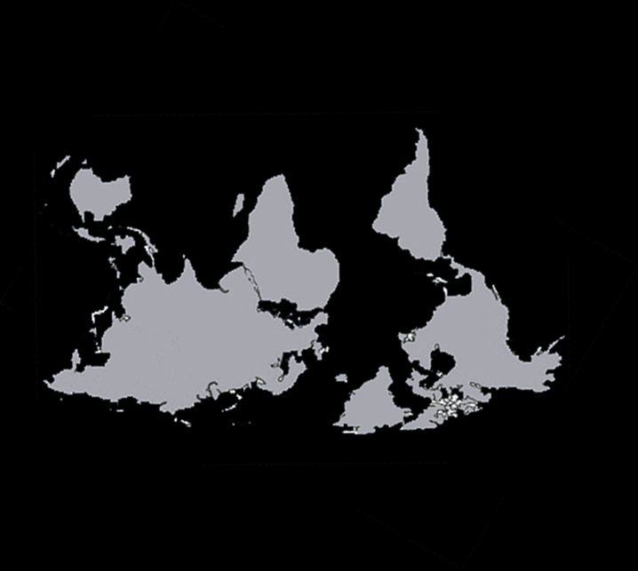
What Anthropology teaches us
Get rid of your familiar biases!

Slide 19
How did we apply Anthropology to studying CSIR?
Our Embeds
1. Worked initially on the sidelines
2. Built tools for the SOC analysts
3. Gained the trust of SOC analysts
4. Co-created tools with the SOC analysts over the course of 18 months!

Slide 20
What does Anthropology tell us about studying the CSIRT?
People know more than they can tell
Knowledge is held in the community
Converting tacit knowledge to explicit knowledge requires systematic study.

Slide 21
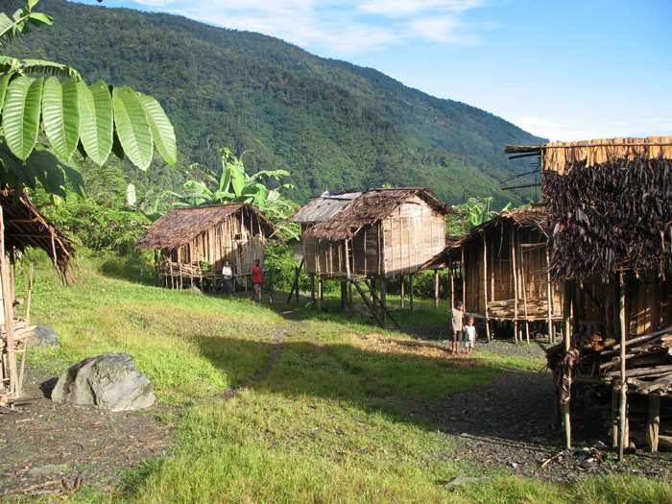
It is not enough to live there.
You have be one of them.
Participant observation is the key.

Slide 22
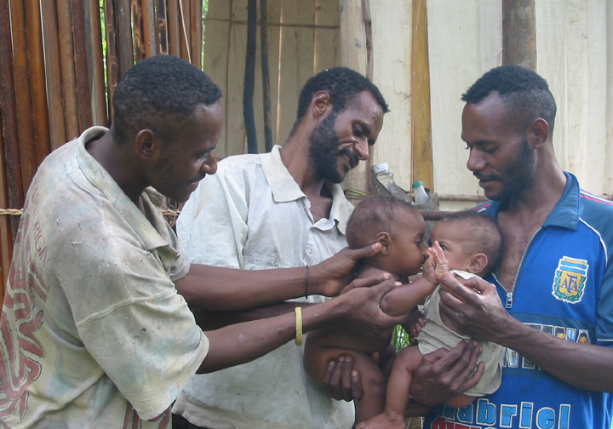
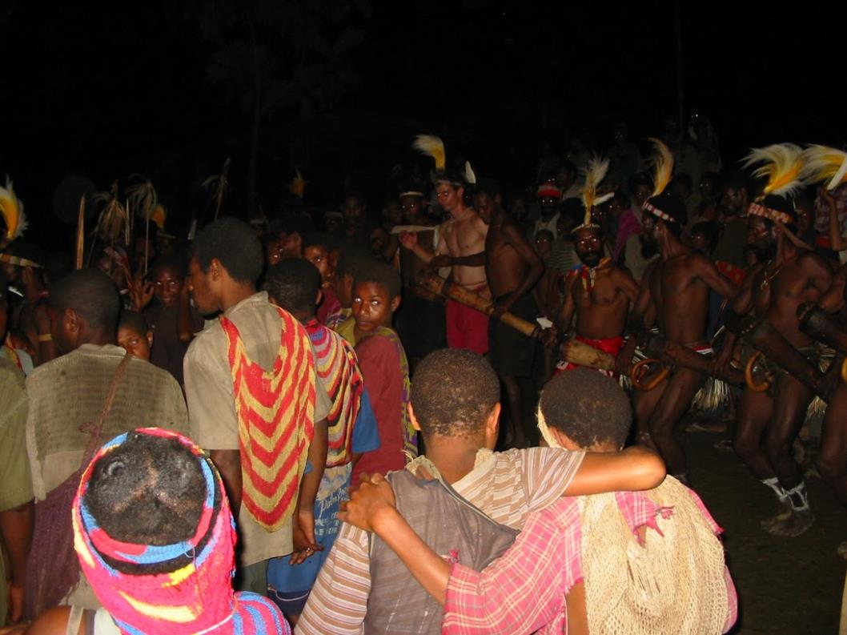
Knowledge comes when the observer achieves the perspective of the observed.
The key is to record that journey.

Slide 23
How to observe what is being said
S-P-E-A-K-I-N-G
Setting and Scene
Participants
Ends
Act Sequence
Key (tone, manner, or spirit of the event)
Instrumentalities (forms and styles used)
Norms (social rules governing the action)
Genre

Slide 24
it’s not what’s being said … it’s what what’s being said says

Slide 25
What we learned when we applied Anthropological techniques
1. SOC analysts’ knowledge is very tribal, there is no alternative to experience.
2. Analysts are not always aware of their own knowledge, which comes out in interactions.
3. It is necessary and possible to become a SOC “insider” to learn how it really works
4. SOC management need to empower and incentivize knowledge sharing among analysts
5. Tool co-creation is the best way to transfer technology into a SOC

Slide 26
Some short-term outcomes of our Anthropological work so far
SOC staff discuss their problems with the researchers today
Our participant observer built a tool for a unique problem they were facing.
A SOC analyst participated in the tool design.
The solution did not require sophisticated or new tools.
The solution reduced the time spent dramatically.
The SOC uses the tool!

Slide 27
Is Anthropology necessary?
The SOC is a unique socio-cultural environment where the activity is very human-centric.
SOC culture is closed and suspicious by necessity.
A short or superficial look at SOC operations would have been misleading.
We have to separate the problems rooted in human behaviors from the technology.
Anthropology give us a methodology to conduct long-term human-oriented study.

Slide 28
Further work
We have an upcoming article in IEEE Security & Privacy Magazine Special Issue on CSIRTs.
The systematic work was limited to one SOC in a university environment.
We have now expanded the study to include two corporate SOCs.
We need to conduct the study at more SOCs.

Slide 29
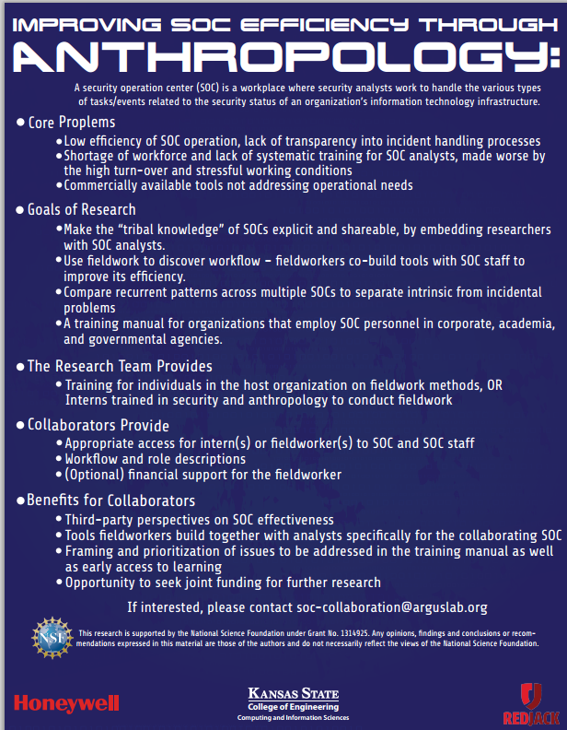
An Invitation to the FIRST Community
We would like to invite participation from the FIRST community SOCs/CSIRTs.
Study participation can benefit both the participating SOC/CSIRT and the community.

Slide 30
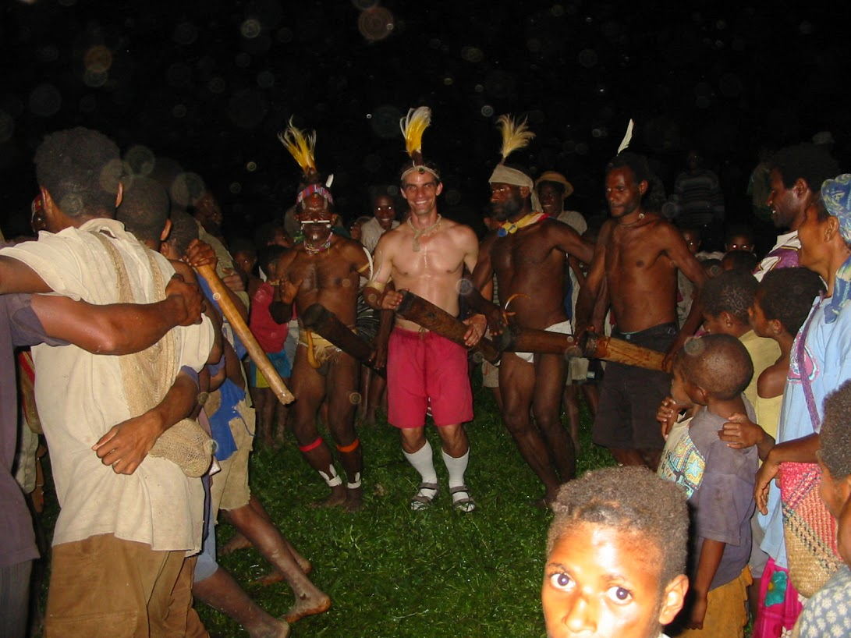
What we hope to achieve in the long run
Deeper understanding of how security analysis works by converting tacit knowledge into explicit
Learn to make our SOC/CSIRT more effective
Learn to train our analysts better
Create a SOC/CSIRT community that learns to observe itself and share better
Notes:
Mention IEEE Magazine article

Slide 31
How and when we share knowledge
in our communities
is not so different after all

